Slide 1

Algorithms
UC Berkeley CalSTAR (Space Technologies and Rocketry Team)
Jasmine Truong, Sean Roh, Rebecca Bennett
Welcome everyone!

Slide 2
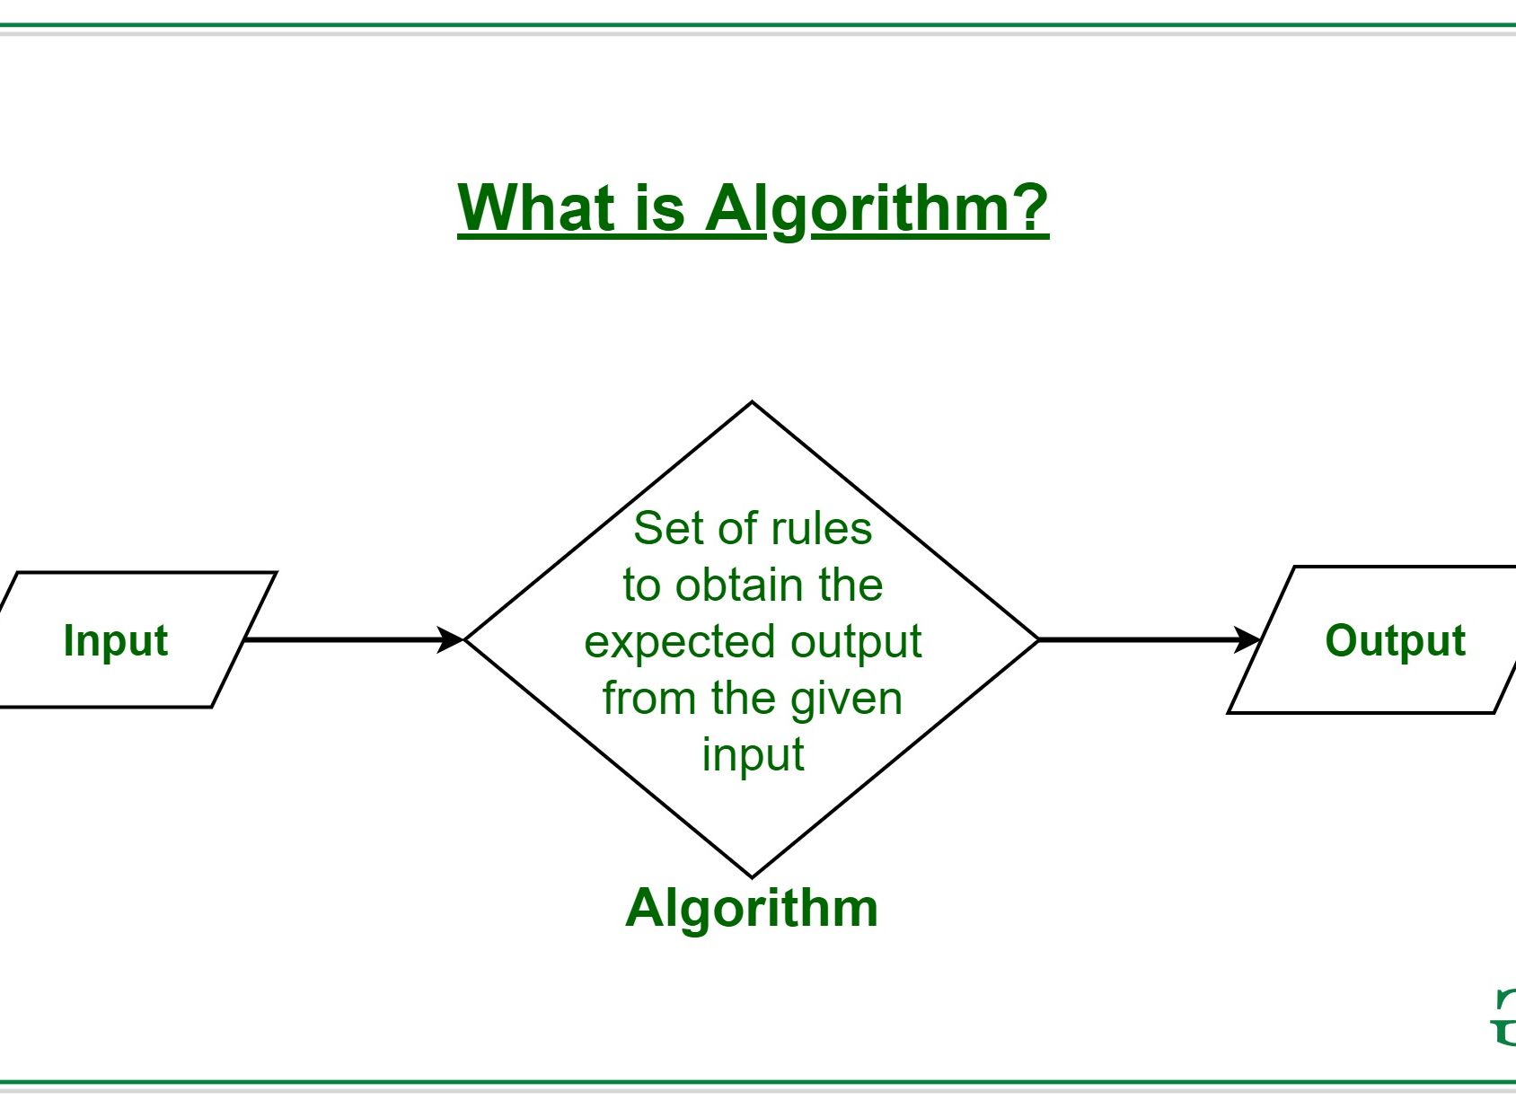
What is An algorithm?
An algorithm is essentially a set of steps to accomplish a task
In computer science and mathematics, it is a sequence of computer-implementable steps used to solve a problem or perform a computation

Slide 3
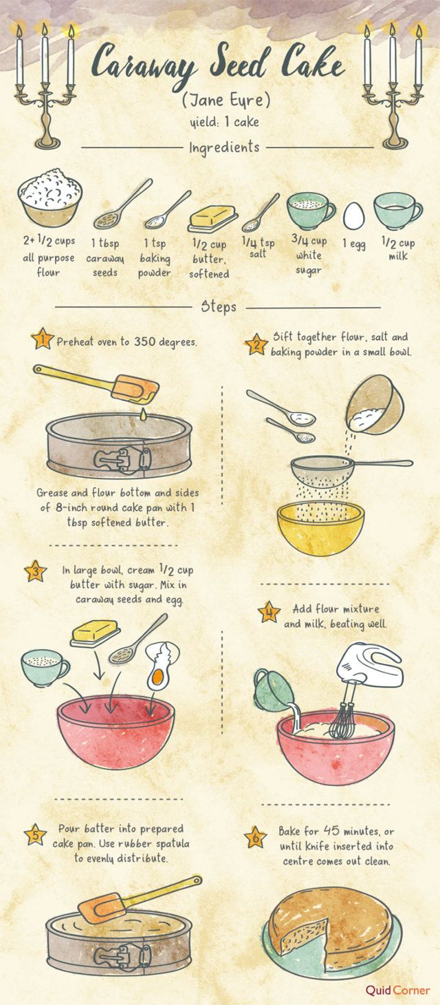
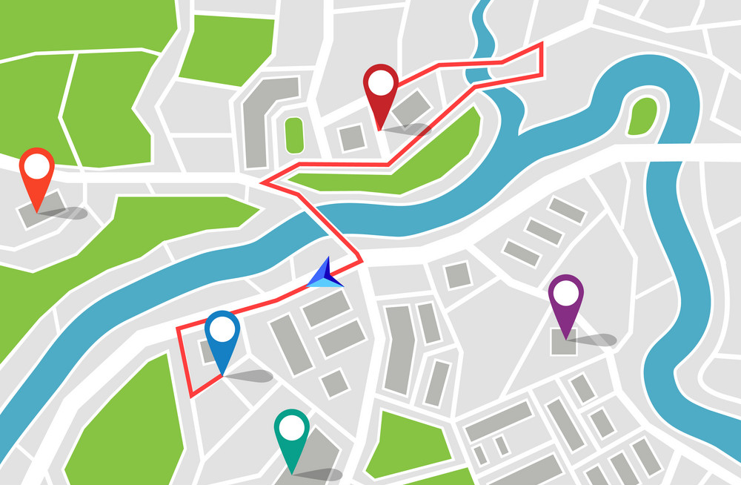
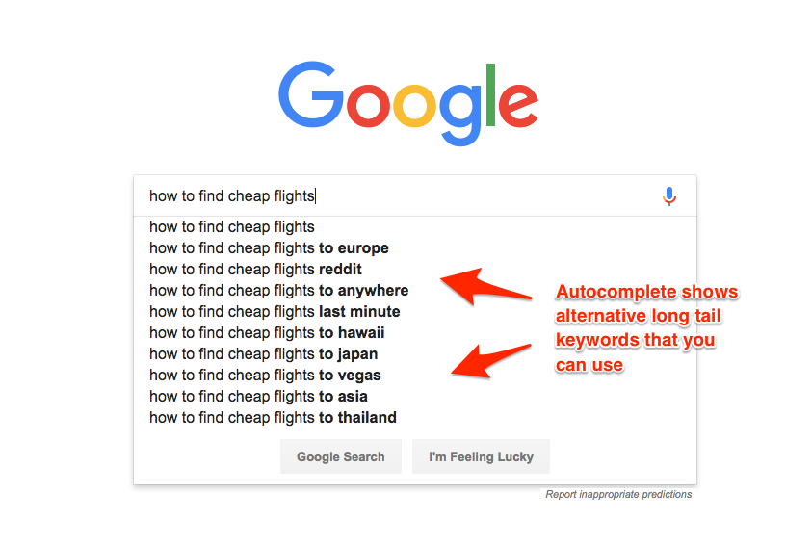
When do we use algorithms?
Algorithms are everywhere in our everyday lives!
Examples:
Recipes
Set of steps to complete a task like baking a cake
GPS Navigation Routes
Finds the fastest route possible from starting point to end point
Uses a search/minimum spanning path algorithm like A* or Dijkstra’s
Autocomplete in Google
Uses a combination of a data structures (Trie Tree) and Tree Traversal algorithms to find the most likely word the user wants to search

Slide 4
Basic Coding Syntax
A
There are certain keywords in coding that can help translate steps in an algorithm so that it is computer implementable
Keywords:
Example: Driving from point A to point B
If and Else: IF the car reaches a corner, turn ELSE drive straight
For/While: WHILE there are no turns detected, drive straight
Return: IF the car has reached point B, RETURN: arrived at destination, complete route and terminate
Bonus: Event Listeners
Event listeners are used when you want your program to be able to take in user inputs and respond to the users’ actions
Keyboard event listeners in gaming:
Waits and listens for player to press a button, program reacts accordingly
Drive straight
corner
Drive straight
corner
Drive straight
B

Slide 5
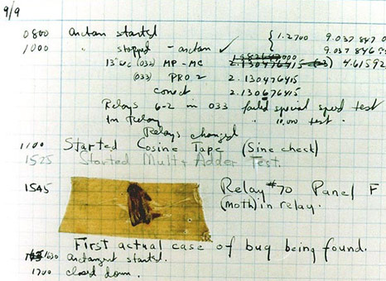
There’s a bug in my code!
Your program doesn’t work as it should, what now?
Debugging is the process of figuring out why your code did not execute correctly
Methods of debugging:
Walking through your code line by line to see where it went wrong (tedious/time-consuming but good for short programs)
Bonus: using print statements
Printing certain values can help you keep track of what your code is doing and if it should be outputting the right things at various intermediate steps
Term ‘bug’ comes from Grace Hopper finding and marking an actual bug in her written code in 1947

Slide 6
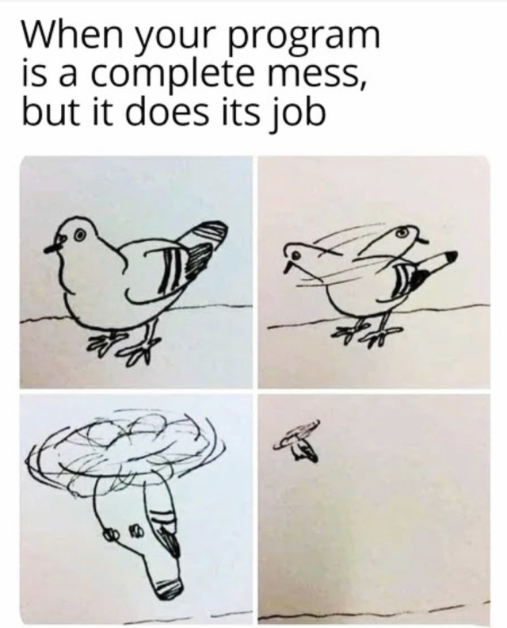
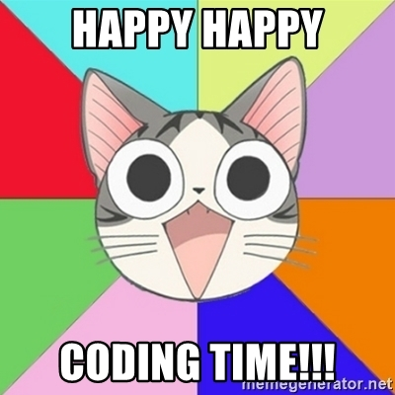
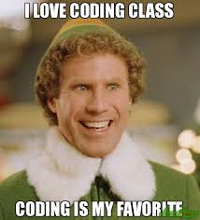
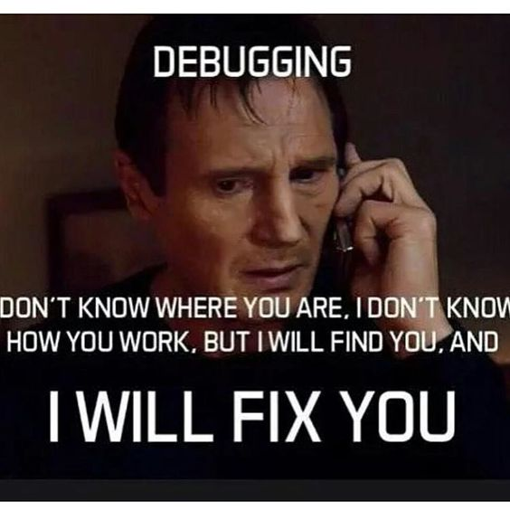
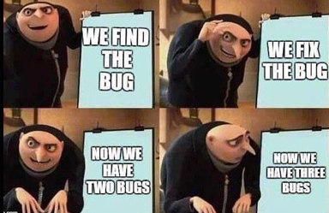
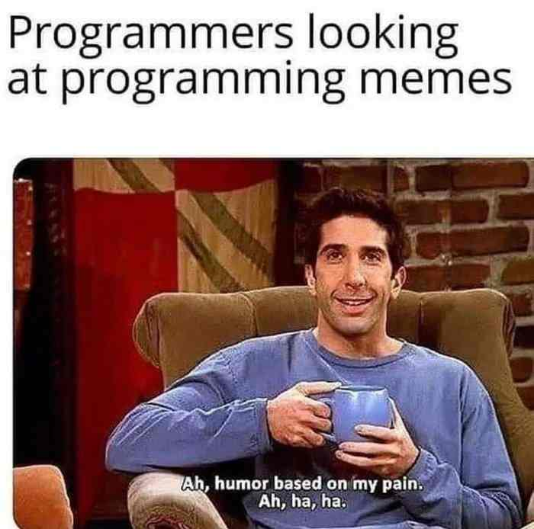
Questions? https://www.codesters.com/project/

